Slide 1
Shift Robust Loss Function
Ananya Deepak Deoghare (UID: 005627628)
Kimaya Kulkarni (UID 805528337)

Slide 2
Motivation
Heart rate (HR) is an important physiological indicator that reflects the physical and mental status of the human body. Contactless HR estimation methods have been developed with the use of Computer vision or deep learning algorithms. Remote PPG (rPPG) works by looking at slight colour changes in mainly the facial region.
Existing methods on vital signs detection have focused on obtaining state-of-the-art performance, with little practical consideration of the input data for the network. One such consideration is the misalignment of the input and ground truth data.
Notes:
In general, HR can be measured by electrocardiography(ECG) or photoplethysmography(PPG), which needs to employ specific sensors to contact with participant’s skin. However, this may cause inconvenience and discomfort to patients especially for a long-term monitoring. PPG is recorded non-invasively using low-cost oximeters. The PPG waveform is complex due to its dependence on the thickness of skin, the portion of muscle fibers in the tissue, and the amount of fat.
Recent work has improved upon this method by incorporating face tracking, skin segmentation, color space transformation, signal decomposition and filtering steps. However, these techniques are expensive to implement and adapt to various lighting conditions, motion and noise. Additionally, these deep learning models are trained on ground truth data collected by contact devices.
For example, in rPPG, we estimate the heart rate using videos of the subject’s face, but the ground truth data is collected using finger oximeter. The rPPG signal measured from the relevant areas of the face is slightly shifted from the PPG signal detected by pulse oximeter, resulting in misaligned video frames and ground truth data.

Slide 3
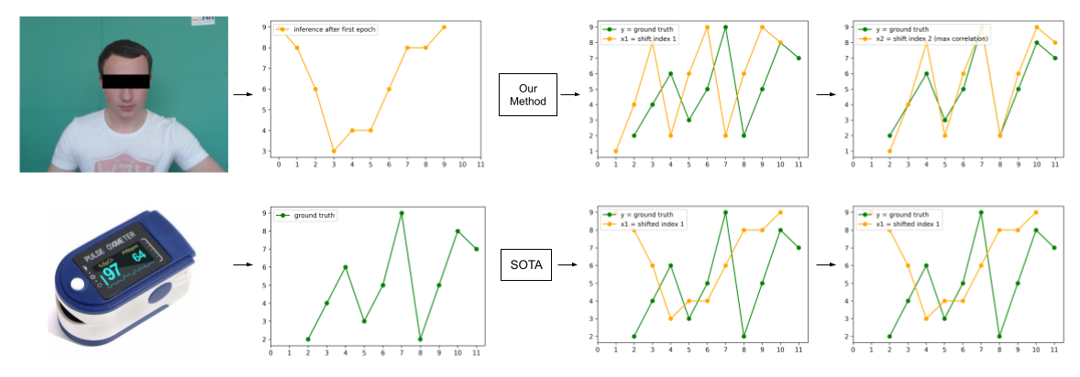
Application chosen: rPPG
Notes:
●Realized our loss function will not work on Deepphys model so had to switch to Physnet.
●Getting Physnet to run on UBFC dataset
●Loss function: Initial max correlation results were random
●We have not concluded which loss function performs better among the two we came up with.
●The loss function has high computational cost

Slide 4
How it’s relevant to what we are learning
We used the below concepts that we learnt in class:
• K fold Cross Validation
• Pearson Correlation (Covariance)
• Mean Squared Error Metrics
• Mean Absolute Error Metrics
Notes:
K fold CV: K-fold cross-validation works well on small data sets (UBFC has 42 videos). All of our data is used in testing our model, thus giving a fair, well-rounded evaluation metric. It may lead to more accurate models since we are eventually utilizing our data to build our model.
and 3. Most papers on rPPG have used the MSE or a Negative Pearson correlation loss function, which do not take misalignment of data into account. We used cross correlation as the base metric and compared our loss function errors to the same! (We use cross correlation, which is generalization of pearson)
We used MAE as the testing metric and compared the values of MAE for the model

Slide 5
How to use the Codebase?
Main Folder:
Src folder:
Errfunc.py : Contains loss functions
Archs.py : Contains model architecture
Dset.py : Dataloaders for different datasets
Train.py
infer.py
Physnet.ipynb : Contains code to train and test on the dataset
Preamble & Imports: Imports necessary packages
Train Physnet: Runs train.py file, needs inputs of dataset name, path, loss function name, number of epochs
Estimate signals of new videos: Test on videos in test set, need to specify test samples, paths, checkpoint to be used
Obtain Results and Metrics: Finds heart rates from windowed rppg signals, finds mae values and averages them.
Notes:
Different files contain loss functions, architectures and dataloaders. Train.py loads the data, trains the chosen model on chosen dataset using the selected loss function
Infer.py tests the selected instance(validation set dropped) on test set and gives the rppg signals as results
Physnet notebook: contains training testing and then finding hr from rppg, and mae values from hr estimates.
UBFC has aligned data, so misaligned using np.random
K-folds to have better idea of error metric

Slide 6
Our Loss Function
MSE + Max Correlation:
Cross correlation gives us how correlated the signals are and index/shift at which the cross correlation is maximum. We then shift the x such that x and y are maximum correlated. This is chosen as closely aligned signal and we calculate loss as as
L_1 = ||x-y||₂.
L_2 = MSE(x,y)
Total Loss = L_1 + L_2
Learning Parameter:
Modified Loss = α * L_1 + (1 - α) * L_2
where α = E/N, N = total number of epochs, E = current epoch
Notes:
Cross correlation loss working
Just max correlation: too random
Addition of MSE gave stability
Weighted sum (logic behind alpha)

Slide 7
Results
Loss Function | Max Shift | Avg Mae
MSE | 10 | 5.946
 | 0 | 3.250
MSE + Max corr | 10 | 4.118
 | 0 | 2.633
(1-𝛂) MSE + 𝛂 (Max corr) 𝛂 = epoch/ total epochs | 10 | 3.136
 | 0 | 2.685
Notes:
- Both proposed loss functions perform better than baseline
- Tried negative pearson coefficient loss for one fold but that gave very high value of mae so did not consider that as a baseline
- Learning parameter improves results for with shift data by a large amount

Slide 8
Timeline
✓ Week 1: Obtained the Dataset and code base.
✓ Week 2: We were able to run Physnet on UBFC Dataset.
✓ Week 3: Tested 2 loss function variations on Physnet, also tested k-folds for 2 variations.
• Week 4: Run further study by changing different parameters to observe shift robustness of loss functions.
• Week 5: Document and interpret the results
Notes:
We did not run DeepPhys on UBFC Dataset, since we realised that it’s not very applicable to our problem. (repeating in challenges)
We have not yet tried implementing PCA on the dataset, but we shall do the same this week. (maybe not necessary?)

Slide 9
Addition of Learning Parameter
Learning Parameter:
Since L_2 is most effective at the beginning of training, and L_1 becomes more and more effective as training progresses, their contribution can be controlled by a parameterα, such that:
Loss = α * L_1 + (1 - α) * L_2
where α = E/N, N = total number of epochs, E = current epoch + 1.

Slide 10
Challenges Faced
Realized our loss function will not work on Deepphys model so had to switch to Physnet.
Getting Physnet to run on UBFC dataset
Loss function: Initial max correlation results were random
We have not concluded which loss function performs better among the two we came up with.
The loss function has high computational cost

Slide 11
Conclusion
We came up with a shift robust loss function which can be used to train a model on misaligned data without any manual changes needed.
Both our loss functions give better results than the baseline on UBFC dataset.

Slide 12
Future Steps
As observed from the results so far for no shift MSE + Max correlation loss works best but for signals with shift the loss function with a learning parameter works well. We want to see if different max shift value gives different results. We plan to test this on max shift =4,7 next. (will try to do it in next two weeks!)
Try out negative pearson coefficient loss function.
Try out different datasets on different models and datasets to test our loss function on rPPG
Find more applications which may have a misalignment in data due to use of different instruments and try out those datasets with our loss function.

Slide 13
Thank you!

